Slide 1
PATH-FINDER
(Impediment Avoider Bot)

Slide 2
ABOUT
Obstacle avoidance is one of the most important aspects of mobile robotics.Here obstacle avoidance is by using ultrasonic sensor it will move in a particular direction and avoid obstacle which is coming in its path.
Pathfinder has numerous applications.

Slide 3
COMPONENTS
The components of the path finder are :
1)Arduino .
2)Metal chassis . 7)Servo motor.
3)Ultrasonic sensor . 8)i2c LCD driver.
4)LCD display .
5)2 way dc motor driver.
6)DC gear motor.

Slide 4
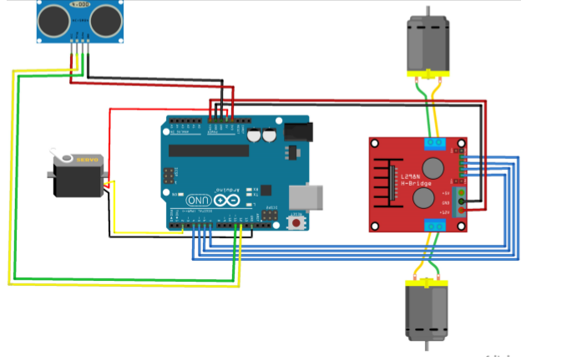
OUTLINE OF PATH-FINDER

Slide 5
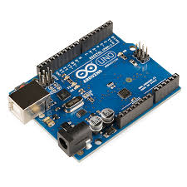
ARDUINO
Arduino is utilized as it is straightforward and simple to apply and can be introduced effectively arduino is the best device for the vehicle of the gadget.
Arduino is a prototyping gadget which is quick and proficient and arduino can communicate with different segments and gadgets like cameras,GPS, transmitters.

Slide 6
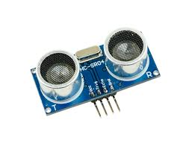
ULTRASONIC SENSOR
The ultrasonic sensor is fundamentally a sound wave producer. This gadget produces sound waves toward the path in which our pathfinder moves or ventures to every part of the sound waves reflects back when they crash into any hindrance or item in their way and now the ultrasonic sensor will figure the impediment separation dependent on the impression of the sound waves and alters the course or way as indicated by it.

Slide 7
WORKING
The pathfinder takes a shot at the rule of sound reflection discharged from the ultrasonic sensor.
The sound waves transmitted from the ultrasonic sensor get reflected when the sound waves crash into any deterrent and from this reflected waves the ultrasonic sensor will figure the separation and afterward changes the way of the pathfinder gadget when snag approaches close to it.

Slide 8
The metal skeleton is utilized to cover the pathfinder and Arduino is utilized for the haggle moving part, the ultrasonic sensor is utilized to compute the separation of the impediment, the LCD show is for seeing the way, the two way DC engine is for the two wheels, Dc gear engine is utilized for the apparatuses in the wheel part, wires is utilized for the association of various segments, the servo engine is utilized rotating,i2c LCD driver is the principle board where all the associations consolidate like a MCB association.

Slide 9
ADVANTAGES
Advantages of path finder are :
1)Used for detecting surrounding situations and acts fast .
2) At the point when this gadget is introduced in an unmanned vehicle and when a hindrance might be living or nonliving comes in the way out of nowhere then the brakes are applied consequently.
3) Can be used as SONAR(sound navigation and ranging).

Slide 10
APPLICATIONS
The application of the pathfinder are :
1) Can be utilized as SONAR(sound navigation and ranging).
2)Can be installed in cars and other automobile to avoid accidents.
3)Used in Unmanned vehicles.

Slide 11
Can be used in automobiles
The pathfinder can be introduced in vehicles and various cars effectively and this pathfinder with the assistance of the ultrasonic sensor in it detects any deterrent or unsettling influence in its way and naturally apply brakes when the driver of the car is out of condition or it can change the way of the car ideally this pathfinder can be exceptionally valuable in oneself driving automobiles as the driver of the vehicle won't be there and the vehicle drives on it claims so this pathfinder will be useful in keeping away from any kind of harm or mishaps

Slide 12
THANK YOU
Team: CODE-BREAKERS

